Slide 1
Algorithms Analysis

Slide 2
Primality Testing

Slide 3
Primality Testing
Definition

Slide 4
Primality Testing
Definition: Let num≥2 be an integer.

Slide 5
Primality Testing
Definition: Let num≥2 be an integer. We say that num is prime, if its only divisors are 1 and num

Slide 6
Primality Testing
Definition: Let num≥2 be an integer. We say that num is prime, if its only divisors are 1 and num Examples:
13 is prime

Slide 7
Primality Testing
Definition: Let num≥2 be an integer. We say that num is prime, if its only divisors are 1 and num Examples:
13 is prime 12 is not prime

Slide 8
Primality Testing
Definition: Let num≥2 be an integer. We say that num is prime, if its only divisors are 1 and num Examples:
13 is prime 12 is not prime
Definition:

Slide 9
Primality Testing
Definition: Let num≥2 be an integer. We say that num is prime, if its only divisors are 1 and num Examples:
13 is prime 12 is not prime
Definition: Let num≥2 be an integer

Slide 10
Primality Testing
Definition: Let num≥2 be an integer. We say that num is prime, if its only divisors are 1 and num Examples:
13 is prime 12 is not prime
Definition: Let num≥2 be an integer, and let d and k be two divisors of num.

Slide 11
Primality Testing
Definition: Let num≥2 be an integer. We say that num is prime, if its only divisors are 1 and num Examples:
13 is prime 12 is not prime
Definition: Let num≥2 be an integer, and let d and k be two divisors of num. We say that k and d are complementary divisors of num

Slide 12
Primality Testing
Definition: Let num≥2 be an integer. We say that num is prime, if its only divisors are 1 and num Examples:
13 is prime 12 is not prime
Definition: Let num≥2 be an integer, and let d and k be two divisors of num. We say that k and d are complementary divisors of num, if d•k=num

Slide 13
Primality Testing
Definition: Let num≥2 be an integer. We say that num is prime, if its only divisors are 1 and num Examples:
13 is prime 12 is not prime
Definition: Let num≥2 be an integer, and let d and k be two divisors of num. We say that k and d are complementary divisors of num, if d•k=num
Examples:
4 and 25 are complementary divisors of 100

Slide 14
Primality Testing
Definition: Let num≥2 be an integer. We say that num is prime, if its only divisors are 1 and num Examples:
13 is prime 12 is not prime
Definition: Let num≥2 be an integer, and let d and k be two divisors of num. We say that k and d are complementary divisors of num, if d•k=num
Examples:
4 and 25 are complementary divisors of 100
5 and 20 are complementary divisors of 100

Slide 15
Primality Testing

Slide 16
Primality Testing
Problem
Write a program that reads from the user an integer greater or equal to 2, and decides if it is a prime number or not

Slide 17
Primality Testing
Problem
Write a program that reads from the user an integer greater or equal to 2, and decides if it is a prime number or not
Example
Please enter an integer, greater or equal to 2:

Slide 18
Primality Testing
Problem
Write a program that reads from the user an integer greater or equal to 2, and decides if it is a prime number or not
Example
Please enter an integer, greater or equal to 2:
911

Slide 19
Primality Testing
Problem
Write a program that reads from the user an integer greater or equal to 2, and decides if it is a prime number or not
Example
Please enter an integer, greater or equal to 2:
911
911 is prime

Slide 20
Primality Testing
bool isPrime(int num){
int countDivs;
countDivs = 0;
for(int i=1; i <= num; i++){
if(num % i == 0)
countDivs++;
}
if(countDivs == 2)
return true;
else
return false;
}

Slide 21
Primality Testing
bool isPrime(int num){
int countDivs;
countDivs = 0;
for(int i=1; i <= num; i++){
if(num % i == 0)
countDivs++;
}
if(countDivs == 2)
return true;
else
return false;
}

Slide 22
Primality Testing
bool isPrime(int num){
int countDivs;
countDivs = 0;
for(int i=1; i <= num; i++){
if(num % i == 0)
countDivs++;
}
if(countDivs == 2)
return true;
else
return false;
}

Slide 23
Primality Testing
bool isPrime(int num){
int countDivs;
countDivs = 0;
for(int i=1; i <= num; i++){
if(num % i == 0)
countDivs++;
}
if(countDivs == 2)
return true;
else
return false;
}

Slide 24
Primality Testing
bool isPrime(int num){
int countDivs;
countDivs = 0;
for(int i=1; i <= num; i++){
if(num % i == 0)
countDivs++;
}
if(countDivs == 2)
return true;
else
return false;
}

Slide 25
Primality Testing
Version I:

Slide 26
Primality Testing
Version I:
Version II:

Slide 27
Primality Testing
Version I:
Version II:

Slide 28
Primality Testing
Version I:
Version II:
num = 100:

Slide 29
Primality Testing
Version I:
Version II:
num = 100:
1 2 4 5 10 20 25 50 100

Slide 30
Primality Testing
Version I:
Version II:
num = 100:
1 2 4 5 10 20 25 50 100

Slide 31
Primality Testing

Slide 32
Primality Testing
k

Slide 33
Primality Testing
k
Let k be a divisor of num in the second half of the range.

Slide 34
Primality Testing
k
Let k be a divisor of num in the second half of the range. That is,

Slide 35
Primality Testing
k
Let k be a divisor of num in the second half of the range. That is,
Let d be k’s complementary divisor

Slide 36
Primality Testing
k
Let k be a divisor of num in the second half of the range. That is,
Let d be k’s complementary divisor, therefore

Slide 37
Primality Testing
k
Let k be a divisor of num in the second half of the range. That is,
Let d be k’s complementary divisor, therefore
We have:

Slide 38
Primality Testing
k
Let k be a divisor of num in the second half of the range. That is,
Let d be k’s complementary divisor, therefore
We have:

Slide 39
Primality Testing
k
Let k be a divisor of num in the second half of the range. That is,
Let d be k’s complementary divisor, therefore
We have:

Slide 40
Primality Testing
k
Let k be a divisor of num in the second half of the range. That is,
Let d be k’s complementary divisor, therefore
We have:

Slide 41
Primality Testing
k
Let k be a divisor of num in the second half of the range. That is,
Let d be k’s complementary divisor, therefore
We have:

Slide 42
Primality Testing
k
Let k be a divisor of num in the second half of the range. That is,
Let d be k’s complementary divisor, therefore
We have:

Slide 43
Primality Testing
k
Let k be a divisor of num in the second half of the range. That is,
Let d be k’s complementary divisor, therefore
We have:

Slide 44
Primality Testing
k
Let k be a divisor of num in the second half of the range. That is,
Let d be k’s complementary divisor, therefore
We have:
Therefore d<2.

Slide 45
Primality Testing
k
Let k be a divisor of num in the second half of the range. That is,
Let d be k’s complementary divisor, therefore
We have:
Therefore d<2. Since d is a divisor

Slide 46
Primality Testing
k
Let k be a divisor of num in the second half of the range. That is,
Let d be k’s complementary divisor, therefore
We have:
Therefore d<2. Since d is a divisor

Slide 47
Primality Testing
k
Let k be a divisor of num in the second half of the range. That is,
Let d be k’s complementary divisor, therefore
We have:
Therefore d<2. Since d is a divisor, we get that d=1.

Slide 48
Primality Testing
k
Let k be a divisor of num in the second half of the range. That is,
Let d be k’s complementary divisor, therefore
We have:
Therefore d<2. Since d is a divisor, we get that d=1.

Slide 49
Primality Testing
k
Let k be a divisor of num in the second half of the range. That is,
Let d be k’s complementary divisor, therefore
We have:
Therefore d<2. Since d is a divisor, we get that d=1.
So:

Slide 50
Primality Testing
k
Let k be a divisor of num in the second half of the range. That is,
Let d be k’s complementary divisor, therefore
We have:
Therefore d<2. Since d is a divisor, we get that d=1.
So: , therefore k = num.

Slide 51
Primality Testing
k
Let k be a divisor of num in the second half of the range. That is,
Let d be k’s complementary divisor, therefore
We have:
Therefore d<2. Since d is a divisor, we get that d=1.
So: , therefore k = num.
This shows that the only divisor in the second half of the range is num itself.

Slide 52
Primality Testing
bool isPrime(int num){
int countDivs;
countDivs = 0;
for(int i=1; i <= num; i++){
if(num % i == 0)
countDivs++;
}
if(countDivs == 2)
return true;
else
return false;
}

Slide 53
Primality Testing
bool isPrime(int num){
int countDivs;
countDivs = 0;
for(int i=1; i <= num; i++){
if(num % i == 0)
countDivs++;
}
if(countDivs == 2)
return true;
else
return false;
}
num / 2

Slide 54
Primality Testing
bool isPrime(int num){
int countDivs;
countDivs = 0;
for(int i=1; i <= num; i++){
if(num % i == 0)
countDivs++;
}
if(countDivs == 2)
return true;
else
return false;
}
num / 2
1

Slide 55
Primality Testing
Version I:
Version II:

Slide 56
Primality Testing
Version I:
Version II:
Version III:

Slide 57
Primality Testing
Version I:
Version II:
Version III:

Slide 58
Primality Testing
Version I:
Version II:
Version III:
num = 100:
1 2 4 5 10 20 25 50 100

Slide 59
Primality Testing
Version I:
Version II:
Version III:
num = 100:
1 2 4 5 10 20 25 50 100

Slide 60
Primality Testing
Version I:
Version II:
Version III:
num = 100:
1 2 4 5 10 20 25 50 100

Slide 61
Primality Testing
1 2 4 5 10 20 25 50 100

Slide 62
Primality Testing
1 2 4 5 10 20 25 50 100

Slide 63
Primality Testing
1 2 4 5 10 20 25 50 100

Slide 64
Primality Testing
1 2 4 5 10 20 25 50 100

Slide 65
Primality Testing
1 2 4 5 10 20 25 50 100

Slide 66
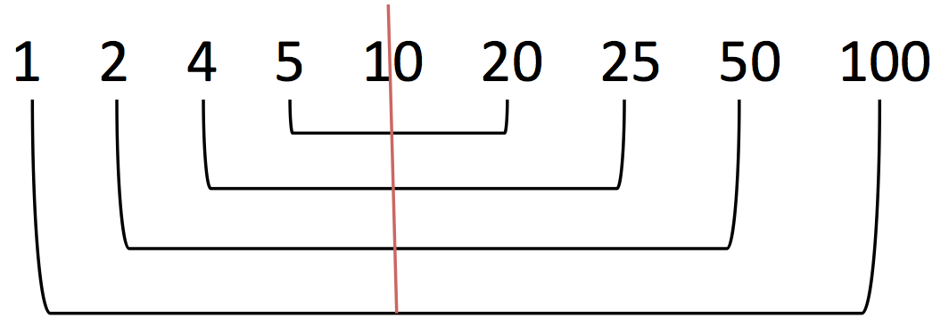
Primality Testing

Slide 67
Primality Testing

Slide 68
Primality Testing
k, d

Slide 69
Primality Testing
k, d
Let k and d be complementary divisors of num

Slide 70
Primality Testing
k, d
Let k and d be complementary divisors of num, and assume that they are both greater than

Slide 71
Primality Testing
k, d
Let k and d be complementary divisors of num, and assume that they are both greater than
We therefore have:

Slide 72
Primality Testing
k, d
Let k and d be complementary divisors of num, and assume that they are both greater than
We therefore have:

Slide 73
Primality Testing
k, d
Let k and d be complementary divisors of num, and assume that they are both greater than
We therefore have:

Slide 74
Primality Testing
k, d
Let k and d be complementary divisors of num, and assume that they are both greater than
We therefore have:

Slide 75
Primality Testing
k, d
Let k and d be complementary divisors of num, and assume that they are both greater than
We therefore have:
This implies that num > num

Slide 76
Primality Testing
k, d
Let k and d be complementary divisors of num, and assume that they are both greater than
We therefore have:
This implies that num > num, which is a contradiction.

Slide 77
Primality Testing
k, d
Let k and d be complementary divisors of num, and assume that they are both greater than
We therefore have:
This implies that num > num, which is a contradiction.

Slide 78
Primality Testing
k, d
Let k and d be complementary divisors of num, and assume that they are both greater than
We therefore have:
This implies that num > num, which is a contradiction.
This shows that at least one in each pair of complementary divisors is less than or equal to

Slide 79
Primality Testing
bool isPrime(int num){
int countDivs;
countDivs = 0;
for(int i=1; i <= num; i++){
if(num % i == 0)
countDivs++;
}
if(countDivs == 2)
return true;
else
return false;
}
num / 2
1

Slide 80
Primality Testing
bool isPrime(int num){
int countDivs;
countDivs = 0;
for(int i=1; i <= num; i++){
if(num % i == 0)
countDivs++;
}
if(countDivs == 2)
return true;
else
return false;
}
sqrt(num)
num / 2
1
1

Slide 81
Primality Testing
Version I:
Version II:
Version III:

Slide 82
Primality Testing - Runtime Analysis

Slide 83
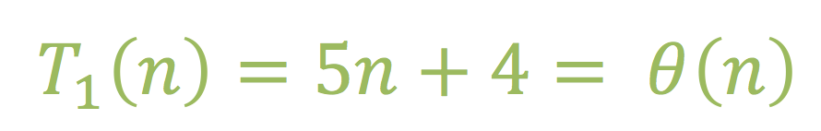
Primality Testing - Runtime Analysis

Slide 84
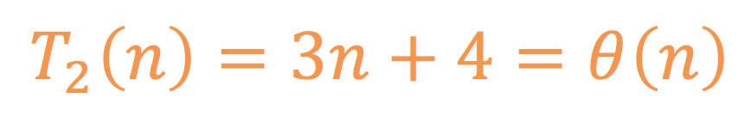
Primality Testing - Runtime Analysis

Slide 85
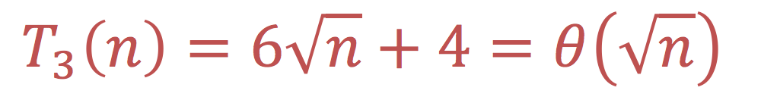
Primality Testing - Runtime Analysis

Slide 86
Runtime Analysis
The running time depends on the size of the input

Slide 87
Runtime Analysis
The running time depends on the size of the input
Parameterize running time by the size of the input

Slide 88
Primality Testing - Runtime Analysis

Slide 89
Primality Testing - Runtime Analysis
Let n be the size of the input (n = num)

Slide 90
Primality Testing - Runtime Analysis
Let n be the size of the input (n = num)

Slide 91
Runtime Analysis
The running time depends on the size of the input
Parameterize running time by the size of the input

Slide 92
Runtime Analysis
The running time depends on the size of the input
Parameterize running time by the size of the input
The running time depends on the operators we use, and on the types of the data they are applied on

Slide 93
Runtime Analysis
The running time depends on the size of the input
Parameterize running time by the size of the input
The running time depends on the operators we use, and on the types of the data they are applied on
Ignore machine-dependent constants. We count each primitive operation as 1

Slide 94
Runtime Analysis
Informal Criteria
We compare the number of primitive operations executed by a process, as a function of its input size

Slide 95
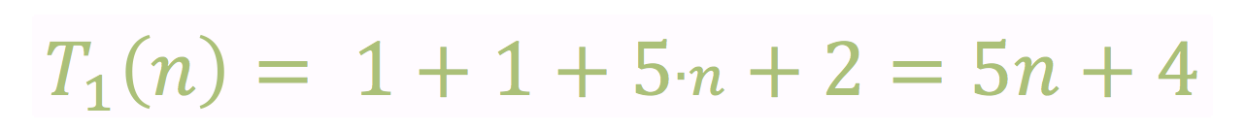
Primality Testing
bool isPrime(int num){
int countDivs;
countDivs = 0;
for(int i=1; i <= num; i++){
if(num % i == 0)
countDivs++;
}
if(countDivs == 2)
return true;
else
return false;
}

Slide 96
Primality Testing
bool isPrime(int num){
int countDivs;
countDivs = 0;
for(int i=1; i <= num; i++){
if(num % i == 0)
countDivs++;
}
if(countDivs == 2)
return true;
else
return false;
}

Slide 97
Primality Testing
bool isPrime(int num){
int countDivs;
countDivs = 0;
for(int i=1; i <= num; i++){
if(num % i == 0)
countDivs++;
}
if(countDivs == 2)
return true;
else
return false;
}

Slide 98
Primality Testing
bool isPrime(int num){
int countDivs;
countDivs = 0;
for(int i=1; i <= num; i++){
if(num % i == 0)
countDivs++;
}
if(countDivs == 2)
return true;
else
return false;
}

Slide 99
Primality Testing
bool isPrime(int num){
int countDivs;
countDivs = 0;
for(int i=1; i <= num; i++){
if(num % i == 0)
countDivs++;
}
if(countDivs == 2)
return true;
else
return false;
}

Slide 100
Primality Testing
bool isPrime(int num){
int countDivs;
countDivs = 0;
for(int i=1; i <= num; i++){
if(num % i == 0)
countDivs++;
}
if(countDivs == 2)
return true;
else
return false;
}

Slide 101
Primality Testing
bool isPrime(int num){
int countDivs;
countDivs = 0;
for(int i=1; i <= num; i++){
if(num % i == 0)
countDivs++;
}
if(countDivs == 2)
return true;
else
return false;
}

Slide 102
Primality Testing
bool isPrime(int num){
int countDivs;
countDivs = 0;
for(int i=1; i <= num; i++){
if(num % i == 0)
countDivs++;
}
if(countDivs == 2)
return true;
else
return false;
}

Slide 103
Primality Testing - Runtime Analysis
Let n be the size of the input (n = num)

Slide 104
Primality Testing - Runtime Analysis
Let n be the size of the input (n = num)

Slide 105
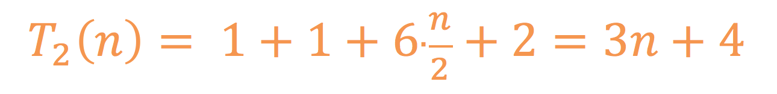
Primality Testing
bool isPrime(int num){
int countDivs;
countDivs = 0;
for(int i=1; i <= num; i++){
if(num % i == 0)
countDivs++;
}
if(countDivs == 2)
return true;
else
return false;
}
num / 2
1

Slide 106
Primality Testing
bool isPrime(int num){
int countDivs;
countDivs = 0;
for(int i=1; i <= num; i++){
if(num % i == 0)
countDivs++;
}
if(countDivs == 2)
return true;
else
return false;
}
num / 2
1

Slide 107
Primality Testing
bool isPrime(int num){
int countDivs;
countDivs = 0;
for(int i=1; i <= num; i++){
if(num % i == 0)
countDivs++;
}
if(countDivs == 2)
return true;
else
return false;
}
num / 2
1

Slide 108
Primality Testing
bool isPrime(int num){
int countDivs;
countDivs = 0;
for(int i=1; i <= num; i++){
if(num % i == 0)
countDivs++;
}
if(countDivs == 2)
return true;
else
return false;
}
num / 2
1

Slide 109
Primality Testing
bool isPrime(int num){
int countDivs;
countDivs = 0;
for(int i=1; i <= num; i++){
if(num % i == 0)
countDivs++;
}
if(countDivs == 2)
return true;
else
return false;
}
num / 2
1

Slide 110
Primality Testing
bool isPrime(int num){
int countDivs;
countDivs = 0;
for(int i=1; i <= num; i++){
if(num % i == 0)
countDivs++;
}
if(countDivs == 2)
return true;
else
return false;
}
num / 2
1

Slide 111
Primality Testing
bool isPrime(int num){
int countDivs;
countDivs = 0;
for(int i=1; i <= num; i++){
if(num % i == 0)
countDivs++;
}
if(countDivs == 2)
return true;
else
return false;
}
num / 2
1

Slide 112
Primality Testing
bool isPrime(int num){
int countDivs;
countDivs = 0;
for(int i=1; i <= num; i++){
if(num % i == 0)
countDivs++;
}
if(countDivs == 2)
return true;
else
return false;
}
num / 2
1

Slide 113
Primality Testing - Runtime Analysis
Let n be the size of the input (n = num)

Slide 114
Primality Testing - Runtime Analysis
Let n be the size of the input (n = num)

Slide 115
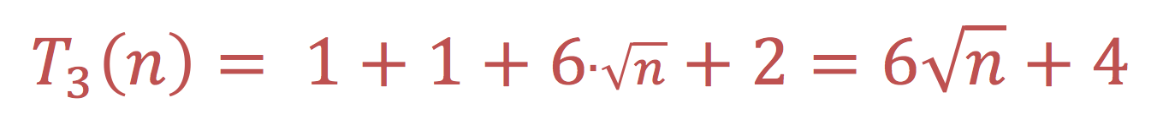
Primality Testing
bool isPrime(int num){
int countDivs;
countDivs = 0;
for(int i=1; i <= num; i++){
if(num % i == 0)
countDivs++;
}
if(countDivs == 2)
return true;
else
return false;
}
sqrt(num)
num / 2
1
1

Slide 116
Primality Testing
bool isPrime(int num){
int countDivs;
countDivs = 0;
for(int i=1; i <= num; i++){
if(num % i == 0)
countDivs++;
}
if(countDivs == 2)
return true;
else
return false;
}
sqrt(num)
num / 2
1
1

Slide 117
Primality Testing
bool isPrime(int num){
int countDivs;
countDivs = 0;
for(int i=1; i <= num; i++){
if(num % i == 0)
countDivs++;
}
if(countDivs == 2)
return true;
else
return false;
}
sqrt(num)
num / 2
1
1

Slide 118
Primality Testing
bool isPrime(int num){
int countDivs;
countDivs = 0;
for(int i=1; i <= num; i++){
if(num % i == 0)
countDivs++;
}
if(countDivs == 2)
return true;
else
return false;
}
sqrt(num)
num / 2
1
1

Slide 119
Primality Testing
bool isPrime(int num){
int countDivs;
countDivs = 0;
for(int i=1; i <= num; i++){
if(num % i == 0)
countDivs++;
}
if(countDivs == 2)
return true;
else
return false;
}
sqrt(num)
num / 2
1
1

Slide 120
Primality Testing
bool isPrime(int num){
int countDivs;
countDivs = 0;
for(int i=1; i <= num; i++){
if(num % i == 0)
countDivs++;
}
if(countDivs == 2)
return true;
else
return false;
}
sqrt(num)
num / 2
1
1

Slide 121
Primality Testing
bool isPrime(int num){
int countDivs;
countDivs = 0;
for(int i=1; i <= num; i++){
if(num % i == 0)
countDivs++;
}
if(countDivs == 2)
return true;
else
return false;
}
sqrt(num)
num / 2
1
1

Slide 122
Primality Testing
bool isPrime(int num){
int countDivs;
countDivs = 0;
for(int i=1; i <= num; i++){
if(num % i == 0)
countDivs++;
}
if(countDivs == 2)
return true;
else
return false;
}
sqrt(num)
num / 2
1
1

Slide 123
Primality Testing - Runtime Analysis
Let n be the size of the input (n = num)

Slide 124
Primality Testing - Runtime Analysis
Let n be the size of the input (n = num)

Slide 125
Primality Testing - Runtime Analysis
Let n be the size of the input (n = num)
>
>

Slide 126
Runtime Analysis
The running time depends on the size of the input
Parameterize running time by the size of the input
The running time depends on the operators we use, and on the types of the data they are applied on
Ignore machine-dependent constants. We count each primitive operation as 1

Slide 127
Runtime Analysis
The running time depends on the size of the input
Parameterize running time by the size of the input
The running time depends on the operators we use, and on the types of the data they are applied on
Ignore machine-dependent constants. We count each primitive operation as 1
The running time depends on the machine’s hardware technology

Slide 128
Runtime Analysis
The running time depends on the size of the input
Parameterize running time by the size of the input
The running time depends on the operators we use, and on the types of the data they are applied on
Ignore machine-dependent constants. We count each primitive operation as 1
The running time depends on the machine’s hardware technology
Make asymptotic analysis: look at the order of growth of T(n)

Slide 129
Runtime Analysis
Informal Criteria
We compare the number of primitive operations executed by a process, as a function of its input size

Slide 130
Runtime Analysis
Informal Criteria
We compare the number of primitive operations executed by a process, as a function of its input size

Slide 131
Runtime Analysis
Informal Criteria
asymptotic order of the
We compare the number of primitive operations executed by a process, as a function of its input size

Slide 132
Runtime Analysis
Informal Criteria
asymptotic order of the
We compare the number of primitive operations executed by a process, as a function of its input size
T(n) = 3n² + 6n -15

Slide 133
Runtime Analysis
Informal Criteria
asymptotic order of the
We compare the number of primitive operations executed by a process, as a function of its input size
T(n) = 3n² + 6n -15 = θ(n²)

Slide 134
Runtime Analysis
Informal Criteria
asymptotic order of the
We compare the number of primitive operations executed by a process, as a function of its input size
T(n) = 3n² + 6n -15 = θ(n²)
Rule of thumb to get the order of growth:

Slide 135
Runtime Analysis
Informal Criteria
asymptotic order of the
We compare the number of primitive operations executed by a process, as a function of its input size
T(n) = 3n² + 6n -15 = θ(n²)
Rule of thumb to get the order of growth:
Drop low-order terms

Slide 136
Runtime Analysis
Informal Criteria
asymptotic order of the
We compare the number of primitive operations executed by a process, as a function of its input size
T(n) = 3n² + 6n -15 = θ(n²)
Rule of thumb to get the order of growth:
Drop low-order terms
Ignore leading constants

Slide 137
Primality Testing - Runtime Analysis
Let n be the size of the input (n = num)

Slide 138
Primality Testing - Runtime Analysis
Let n be the size of the input (n = num)

Slide 139
Primality Testing - Runtime Analysis
Let n be the size of the input (n = num)

Slide 140
Primality Testing - Runtime Analysis
Let n be the size of the input (n = num)

Slide 141
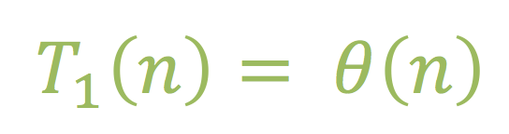
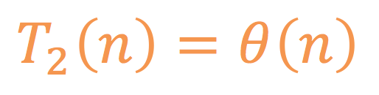
Primality Testing - Runtime Analysis
Let n be the size of the input (n = num)

Slide 142
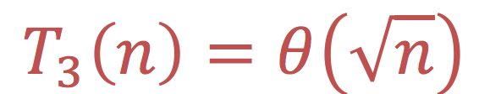
Primality Testing - Runtime Analysis
Let n be the size of the input (n = num)

Slide 143
Primality Testing - Runtime Analysis
Let n be the size of the input (n = num)
=
Conclusions:
T₁(n) and T₂(n) are asymptotically equivalent

Slide 144
Primality Testing - Runtime Analysis
Let n be the size of the input (n = num)
=
>
Conclusions:
T₁(n) and T₂(n) are asymptotically equivalent
T₃(n) is asymptotically better than T₁(n) and T₂(n)

Slide 145
Runtime Analysis
Informal Criteria
We compare the asymptotic order of the number of primitive operations executed by a process, as a function of its input size
T(n) = 3n² + 6n -15 = θ(n²)
Rule of thumb to get the order of growth:
Drop low-order terms
Ignore leading constants

Slide 146
Runtime Analysis
Informal Criteria
We compare the asymptotic order of the number of primitive operations executed by a process, as a function of its input size
T(n) = 3n² + 6n -15 = θ(n²)
Rule of thumb to get the order of growth:
Drop low-order terms
Ignore leading constants
More Formally . . .

Slide 147
Asymptotic Analysis
Θ definition

Slide 148
Asymptotic Analysis
Θ definition
Definition
Let f(n) and g(n) be two functions mapping positive integers to positive real numbers.

Slide 149
Asymptotic Analysis
Θ definition
Definition
Let f(n) and g(n) be two functions mapping positive integers to positive real numbers.
We say that f(n)=θ(g(n))

Slide 150
Asymptotic Analysis
Θ definition
Definition
Let f(n) and g(n) be two functions mapping positive integers to positive real numbers.
We say that f(n)=θ(g(n)) if there exist positive real constants c₁, c₂

Slide 151
Asymptotic Analysis
Θ definition
Definition
Let f(n) and g(n) be two functions mapping positive integers to positive real numbers.
We say that f(n)=θ(g(n)) if there exist positive real constants c₁, c₂ and a positive integer constant n₀

Slide 152
Asymptotic Analysis
Θ definition
Definition
Let f(n) and g(n) be two functions mapping positive integers to positive real numbers.
We say that f(n)=θ(g(n)) if there exist positive real constants c₁, c₂ and a positive integer constant n₀ such that c₂g(n) ≤ f(n) ≤ c₁g(n) for all n≥n₀

Slide 153
Asymptotic Analysis
Θ definition
Definition
Let f(n) and g(n) be two functions mapping positive integers to positive real numbers.
We say that f(n)=θ(g(n)) if there exist positive real constants c₁, c₂ and a positive integer constant n₀ such that c₂g(n) ≤ f(n) ≤ c₁g(n) for all n≥n₀
f(n)
running time
size of input

Slide 154
Asymptotic Analysis
Θ definition
Definition
Let f(n) and g(n) be two functions mapping positive integers to positive real numbers.
We say that f(n)=θ(g(n)) if there exist positive real constants c₁, c₂ and a positive integer constant n₀ such that c₂g(n) ≤ f(n) ≤ c₁g(n) for all n≥n₀
4•g(n)
f(n)
running time
size of input

Slide 155
Asymptotic Analysis
Θ definition
Definition
Let f(n) and g(n) be two functions mapping positive integers to positive real numbers.
We say that f(n)=θ(g(n)) if there exist positive real constants c₁, c₂ and a positive integer constant n₀ such that c₂g(n) ≤ f(n) ≤ c₁g(n) for all n≥n₀
4•g(n)
f(n)
running time
⅓•g(n)
size of input

Slide 156
Asymptotic Analysis
Θ definition
Definition
Let f(n) and g(n) be two functions mapping positive integers to positive real numbers.
We say that f(n)=θ(g(n)) if there exist positive real constants c₁, c₂ and a positive integer constant n₀ such that c₂g(n) ≤ f(n) ≤ c₁g(n) for all n≥n₀
4•g(n)
f(n)
running time
⅓•g(n)
8
size of input

Slide 157
Asymptotic Analysis
Θ definition
Definition
Let f(n) and g(n) be two functions mapping positive integers to positive real numbers.
We say that f(n)=θ(g(n)) if there exist positive real constants c₁, c₂ and a positive integer constant n₀ such that c₂g(n) ≤ f(n) ≤ c₁g(n) for all n≥n₀
4•g(n)
f(n)
running time
⅓•g(n)
n₀ = 8
c₁ = 4
c₂ = ⅓
8
size of input

Slide 158
Asymptotic Analysis
Θ definition
Definition
Let f(n) and g(n) be two functions mapping positive integers to positive real numbers.
We say that f(n)=θ(g(n)) if there exist positive real constants c₁, c₂ and a positive integer constant n₀ such that c₂g(n) ≤ f(n) ≤ c₁g(n) for all n≥n₀
4•g(n)
f(n)
running time
⅓•g(n)
n₀ = 8
c₁ = 4
c₂ = ⅓
⇧
f(n) = θ(g(n))
8
size of input

Slide 159
Asymptotic Analysis
Θ definition
Show that: 3n² + 6n -15 = θ(n² )
3n² ≤

Slide 160
Asymptotic Analysis
Θ definition
Show that: 3n² + 6n -15 = θ(n² )
3n² ≤
f(n)
g(n)

Slide 161
Asymptotic Analysis
Θ definition
Show that: 3n² + 6n -15 = θ(n² )
Proof:
3n² ≤
f(n)
g(n)

Slide 162
Asymptotic Analysis
Θ definition
Show that: 3n² + 6n -15 = θ(n² )
Proof:
if we take c₁ = ____
c₂ = ____
n₀ = ____
3n² ≤
f(n)
g(n)

Slide 163
Asymptotic Analysis
Θ definition
Show that: 3n² + 6n -15 = θ(n² )
Proof:
if we take c₁ = ____
c₂ = ____
n₀ = ____
Then for all n ≥ n₀ we have:
3n² ≤
f(n)
g(n)

Slide 164
Asymptotic Analysis
Θ definition
Show that: 3n² + 6n -15 = θ(n² )
Proof:
if we take c₁ = ____
c₂ = ____
n₀ = ____
Then for all n ≥ n₀ we have:
3n² ≤ 3n² + 6n - 15
f(n)
g(n)

Slide 165
Asymptotic Analysis
Θ definition
Show that: 3n² + 6n -15 = θ(n² )
Proof:
if we take c₁ = ____
c₂ = ____
n₀ = ____
Then for all n ≥ n₀ we have:
3n² ≤ 3n² + 6n - 15 ≤ 3n² + 6n
f(n)
g(n)

Slide 166
Asymptotic Analysis
Θ definition
Show that: 3n² + 6n -15 = θ(n² )
Proof:
if we take c₁ = ____
c₂ = ____
n₀ = ____
Then for all n ≥ n₀ we have:
3n² ≤ 3n² + 6n - 15 ≤ 3n² + 6n ≤ 3n² + 6n²
f(n)
g(n)

Slide 167
Asymptotic Analysis
Θ definition
Show that: 3n² + 6n -15 = θ(n² )
Proof:
if we take c₁ = ____
c₂ = ____
n₀ = ____
Then for all n ≥ n₀ we have:
3n² ≤ 3n² + 6n - 15 ≤ 3n² + 6n ≤ 3n² + 6n² = 9n²
f(n)
g(n)

Slide 168
Asymptotic Analysis
Θ definition
Show that: 3n² + 6n -15 = θ(n² )
Proof:
if we take c₁ = ____
c₂ = ____
n₀ = ____
Then for all n ≥ n₀ we have:
3n² ≤ 3n² + 6n - 15 ≤ 3n² + 6n ≤ 3n² + 6n² = 9n²
f(n)
g(n)
9

Slide 169
Asymptotic Analysis
Θ definition
Show that: 3n² + 6n -15 = θ(n² )
Proof:
if we take c₁ = ____
c₂ = ____
n₀ = ____
Then for all n ≥ n₀ we have:
3n² ≤ 3n² + 6n - 15 ≤ 3n² + 6n ≤ 3n² + 6n² = 9n²
f(n)
g(n)
9

Slide 170
Asymptotic Analysis
Θ definition
Show that: 3n² + 6n -15 = θ(n² )
Proof:
if we take c₁ = ____
c₂ = ____
n₀ = ____
Then for all n ≥ n₀ we have:
3n² ≤ 3n² + 6n - 15 ≤ 3n² + 6n ≤ 3n² + 6n² = 9n²
f(n)
g(n)
9
6n – 15 ≥ 0

Slide 171
Asymptotic Analysis
Θ definition
Show that: 3n² + 6n -15 = θ(n² )
Proof:
if we take c₁ = ____
c₂ = ____
n₀ = ____
Then for all n ≥ n₀ we have:
3n² ≤ 3n² + 6n - 15 ≤ 3n² + 6n ≤ 3n² + 6n² = 9n²
f(n)
g(n)
9
6n – 15 ≥ 0
6n ≥ 15

Slide 172
Asymptotic Analysis
Θ definition
Show that: 3n² + 6n -15 = θ(n² )
Proof:
if we take c₁ = ____
c₂ = ____
n₀ = ____
Then for all n ≥ n₀ we have:
3n² ≤ 3n² + 6n - 15 ≤ 3n² + 6n ≤ 3n² + 6n² = 9n²
f(n)
g(n)
9
6n – 15 ≥ 0
6n ≥ 15
n ≥ 2.5

Slide 173
Asymptotic Analysis
Θ definition
Show that: 3n² + 6n -15 = θ(n² )
Proof:
if we take c₁ = ____
c₂ = ____
n₀ = ____
Then for all n ≥ n₀ we have:
3n² ≤ 3n² + 6n - 15 ≤ 3n² + 6n ≤ 3n² + 6n² = 9n²
f(n)
g(n)
9
3
6n – 15 ≥ 0
6n ≥ 15
n ≥ 2.5

Slide 174
Asymptotic Analysis
Θ definition
Show that: 3n² + 6n -15 = θ(n² )
Proof:
if we take c₁ = ____
c₂ = ____
n₀ = ____
Then for all n ≥ n₀ we have:
3n² ≤ 3n² + 6n - 15 ≤ 3n² + 6n ≤ 3n² + 6n² = 9n²
f(n)
g(n)
9
3
3
6n – 15 ≥ 0
6n ≥ 15
n ≥ 2.5

Slide 175
Asymptotic Analysis
Θ definition
Show that: 3n² + 6n -15 = θ(n² )
Proof:
if we take c₁ = ____
c₂ = ____
n₀ = ____
Then for all n ≥ n₀ we have:
3n² ≤ 3n² + 6n - 15 ≤ 3n² + 6n ≤ 3n² + 6n² = 9n²
3n² ≤ 3n² + 6n – 15 ≤ 9n²
f(n)
g(n)
9
3
3
6n – 15 ≥ 0
6n ≥ 15
n ≥ 2.5
⇧

Slide 176
Asymptotic Analysis
Θ definition
Show that: 3n² + 6n -15 = θ(n² )
Proof:
if we take c₁ = ____
c₂ = ____
n₀ = ____
Then for all n ≥ n₀ we have:
3n² ≤ 3n² + 6n - 15 ≤ 3n² + 6n ≤ 3n² + 6n² = 9n²
3n² ≤ 3n² + 6n – 15 ≤ 9n²
Therefore: 3n² + 6n – 15 = θ(n²)
f(n)
g(n)
9
3
3
6n – 15 ≥ 0
6n ≥ 15
n ≥ 2.5
⇧

Slide 177
Runtime Analysis
Example I
int main(){
int n, i, j;
cout<<”Please enter n:”<<endl;
cin>>n;
for(i = 1; i <= n; i++){
for(j = 1; j <= n; j++)
cout<<‘*‘;
cout<<endl;
}
return 0;
}

Slide 178
Runtime Analysis
Example I
int main(){
int n, i, j;
cout<<”Please enter n:”<<endl;
cin>>n;
for(i = 1; i <= n; i++){
for(j = 1; j <= n; j++)
cout<<‘*‘;
cout<<endl;
}
return 0;
}
* * * *
* * * *
* * * *
* * * *

Slide 179
Runtime Analysis
Example I
int main(){
int n, i, j;
cout<<”Please enter n:”<<endl;
cin>>n;
for(i = 1; i <= n; i++){
for(j = 1; j <= n; j++)
cout<<‘*‘;
cout<<endl;
}
return 0;
}
* * * *
* * * *
* * * *
* * * *
T(n) =

Slide 180
Runtime Analysis
Example I
int main(){
int n, i, j;
cout<<”Please enter n:”<<endl;
cin>>n;
for(i = 1; i <= n; i++){
for(j = 1; j <= n; j++)
cout<<‘*‘;
cout<<endl;
}
return 0;
}
* * * *
* * * *
* * * *
* * * *
T(n) =

Slide 181
Runtime Analysis
Example I
int main(){
int n, i, j;
cout<<”Please enter n:”<<endl;
cin>>n;
for(i = 1; i <= n; i++){
for(j = 1; j <= n; j++)
cout<<‘*‘;
cout<<endl;
}
return 0;
}
n
* * * *
* * * *
* * * *
* * * *
T(n) =

Slide 182
Runtime Analysis
Example I
int main(){
int n, i, j;
cout<<”Please enter n:”<<endl;
cin>>n;
for(i = 1; i <= n; i++){
for(j = 1; j <= n; j++)
cout<<‘*‘;
cout<<endl;
}
return 0;
}
n
* * * *
* * * *
* * * *
* * * *
T(n) =

Slide 183
Runtime Analysis
Example I
int main(){
int n, i, j;
cout<<”Please enter n:”<<endl;
cin>>n;
for(i = 1; i <= n; i++){
for(j = 1; j <= n; j++)
cout<<‘*‘;
cout<<endl;
}
return 0;
}
n•n
n
* * * *
* * * *
* * * *
* * * *
T(n) =

Slide 184
Runtime Analysis
Example I
int main(){
int n, i, j;
cout<<”Please enter n:”<<endl;
cin>>n;
for(i = 1; i <= n; i++){
for(j = 1; j <= n; j++)
cout<<‘*‘;
cout<<endl;
}
return 0;
}
n•n
n
* * * *
* * * *
* * * *
* * * *
T(n) = θ(n²)

Slide 185
Runtime Analysis
Example I
int main(){
int n, i, j;
cout<<”Please enter n:”<<endl;
cin>>n;
for(i = 1; i <= n; i++){
for(j = 1; j <= n; j++)
cout<<‘*‘;
cout<<endl;
}
return 0;
}
n•n
n
* * * *
* * * *
* * * *
* * * *
T(n) = θ(n²)

Slide 186
Runtime Analysis
Example I
int main(){
int n, i, j;
cout<<”Please enter n:”<<endl;
cin>>n;
for(i = 1; i <= n; i++){
for(j = 1; j <= n; j++)
cout<<‘*‘;
cout<<endl;
}
return 0;
}

Slide 187
Runtime Analysis
Example II
int main(){
int n, i, j;
cout<<”Please enter n:”<<endl;
cin>>n;
for(i = 1; i <= n; i++){
for(j = 1; j <= i; j++)
cout<<‘*‘;
cout<<endl;
}
return 0;
}

Slide 188
Runtime Analysis
Example II
int main(){
int n, i, j;
cout<<”Please enter n:”<<endl;
cin>>n;
for(i = 1; i <= n; i++){
for(j = 1; j <= i; j++)
cout<<‘*‘;
cout<<endl;
}
return 0;
}
*
* *
* * *
* * * *

Slide 189
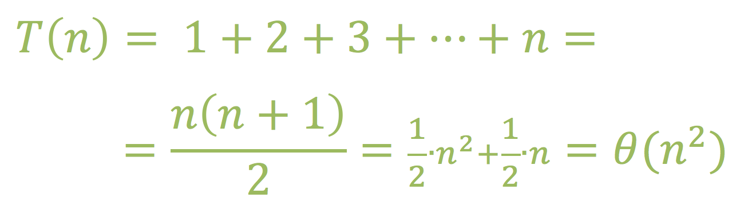
Runtime Analysis
Example II
int main(){
int n, i, j;
cout<<”Please enter n:”<<endl;
cin>>n;
for(i = 1; i <= n; i++){
for(j = 1; j <= i; j++)
cout<<‘*‘;
cout<<endl;
}
return 0;
}
*
* *
* * *
* * * *

Slide 190
Runtime Analysis
Example II
int main(){
int n, i, j;
cout<<”Please enter n:”<<endl;
cin>>n;
for(i = 1; i <= n; i++){
for(j = 1; j <= i; j++)
cout<<‘*‘;
cout<<endl;
}
return 0;
}
*
* *
* * *
* * * *

Slide 191
Runtime Analysis
Example II
int main(){
int n, i, j;
cout<<”Please enter n:”<<endl;
cin>>n;
for(i = 1; i <= n; i++){
for(j = 1; j <= i; j++)
cout<<‘*‘;
cout<<endl;
}
return 0;
}
i
*
* *
* * *
* * * *

Slide 192
Runtime Analysis
Example II
int main(){
int n, i, j;
cout<<”Please enter n:”<<endl;
cin>>n;
for(i = 1; i <= n; i++){
for(j = 1; j <= i; j++)
cout<<‘*‘;
cout<<endl;
}
return 0;
}
i
*
* *
* * *
* * * *

Slide 193
Runtime Analysis
Example II
int main(){
int n, i, j;
cout<<”Please enter n:”<<endl;
cin>>n;
for(i = 1; i <= n; i++){
for(j = 1; j <= i; j++)
cout<<‘*‘;
cout<<endl;
}
return 0;
}
i
*
* *
* * *
* * * *

Slide 194
Runtime Analysis
Example II
int main(){
int n, i, j;
cout<<”Please enter n:”<<endl;
cin>>n;
for(i = 1; i <= n; i++){
for(j = 1; j <= i; j++)
cout<<‘*‘;
cout<<endl;
}
return 0;
}
i
*
* *
* * *
* * * *

Slide 195
Runtime Analysis
Example II
int main(){
int n, i, j;
cout<<”Please enter n:”<<endl;
cin>>n;
for(i = 1; i <= n; i++){
for(j = 1; j <= i; j++)
cout<<‘*‘;
cout<<endl;
}
return 0;
}
i
*
* *
* * *
* * * *

Slide 196
Runtime Analysis
Example II
int main(){
int n, i, j;
cout<<”Please enter n:”<<endl;
cin>>n;
for(i = 1; i <= n; i++){
for(j = 1; j <= i; j++)
cout<<‘*‘;
cout<<endl;
}
return 0;
}
i
*
* *
* * *
* * * *

Slide 197
Runtime Analysis
Example II
int main(){
int n, i, j;
cout<<”Please enter n:”<<endl;
cin>>n;
for(i = 1; i <= n; i++){
for(j = 1; j <= i; j++)
cout<<‘*‘;
cout<<endl;
}
return 0;
}
i
*
* *
* * *
* * * *

Slide 198
Runtime Analysis
Example II
int main(){
int n, i, j;
cout<<”Please enter n:”<<endl;
cin>>n;
for(i = 1; i <= n; i++){
for(j = 1; j <= i; j++)
cout<<‘*‘;
cout<<endl;
}
return 0;
}
i
*
* *
* * *
* * * *

Slide 199
Runtime Analysis
Example II
int main(){
int n, i, j;
cout<<”Please enter n:”<<endl;
cin>>n;
for(i = 1; i <= n; i++){
for(j = 1; j <= i; j++)
cout<<‘*‘;
cout<<endl;
}
return 0;
}
i
*
* *
* * *
* * * *

Slide 200
Runtime Analysis
Example II
int main(){
int n, i, j;
cout<<”Please enter n:”<<endl;
cin>>n;
for(i = 1; i <= n; i++){
for(j = 1; j <= i; j++)
cout<<‘*‘;
cout<<endl;
}
return 0;
}
i
*
* *
* * *
* * * *
⇧
T(n) = θ(n²)

Slide 201
Runtime Analysis
Example II
int main(){
int n, i, j;
cout<<”Please enter n:”<<endl;
cin>>n;
for(i = 1; i <= n; i++){
for(j = 1; j <= i; j++)
cout<<‘*‘;
cout<<endl;
}
return 0;
}
i
*
* *
* * *
* * * *
⇧
T(n) = θ(n²)

